Slide 1
Yeezy vs. Off White
Sneaker Resell Value & Social Media Hype
Kirstie Jones, James Nguyen, Amy Vong, Nicole Zheng

Slide 2
What has the biggest effect on resell value?
Social Media Buzz (Google Trends)
Brand Name
Color way
Size
Geography
Notes:
KJ: Our starter data came from Stock X. A website that held a contest last year and offered prizes for the best visualizations of the given data. The data contained information on Yeezy and Off White sneakers including their original sale price, resell value, size, color way, and buyer state from Sept 2017 to February 2019. We used Google Trends as a proxy for social media buzz in lieu of access to historic social media API data.
Our proposed questions:
Is there a correlation between social media influence and sneaker resell value?
Is there a correlation between resell value and shoe size?
Is there a correlation between resell value and color way?
Is there a correlation between social impressions and resell value or velocity of buy?

Slide 3
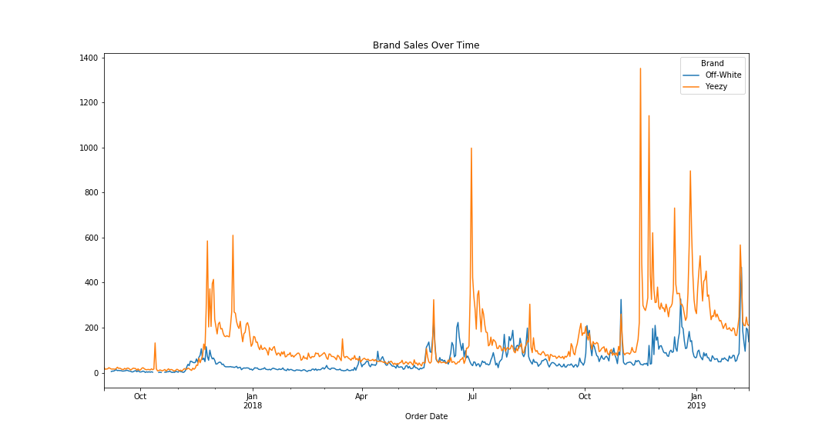
Notes:
KJ: This graph shows a breakdown comparing the 2 brands (Yeezy and Off White) and tracks the sales over time

Slide 4
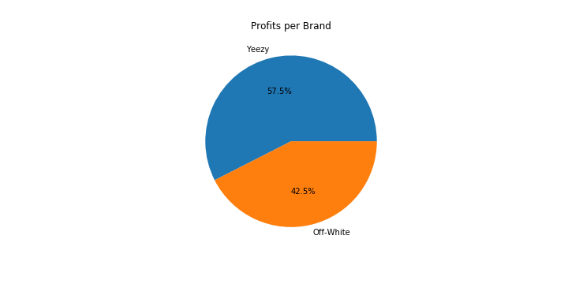
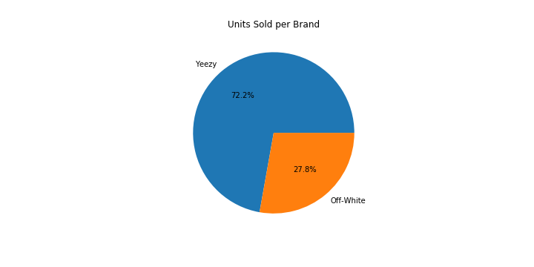
Notes:
KJ: We were surprised to find that even though Yeezy sold more units, Off White resells had more profitability

Slide 5
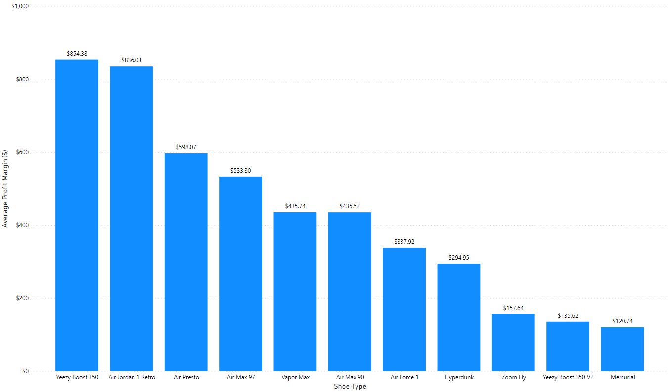
Avg Money Made Reselling
Notes:
AV:

Slide 6
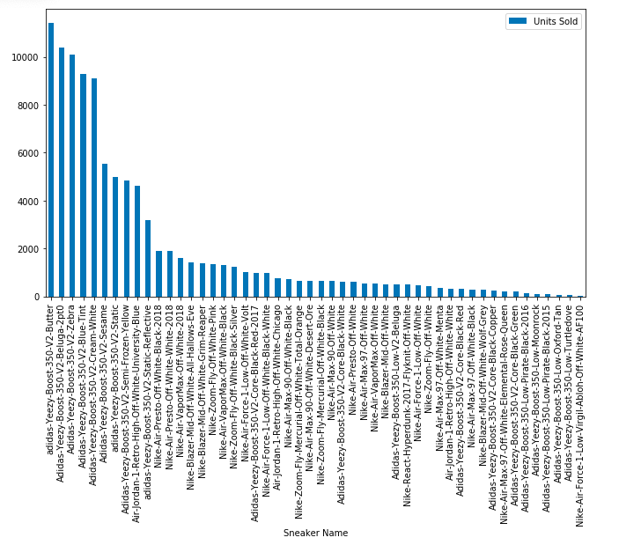
Sneaker Units + Color Way Sold
Notes:
AV:

Slide 7
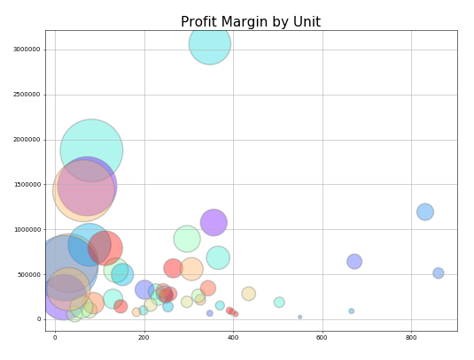
Notes:
AV

Slide 8
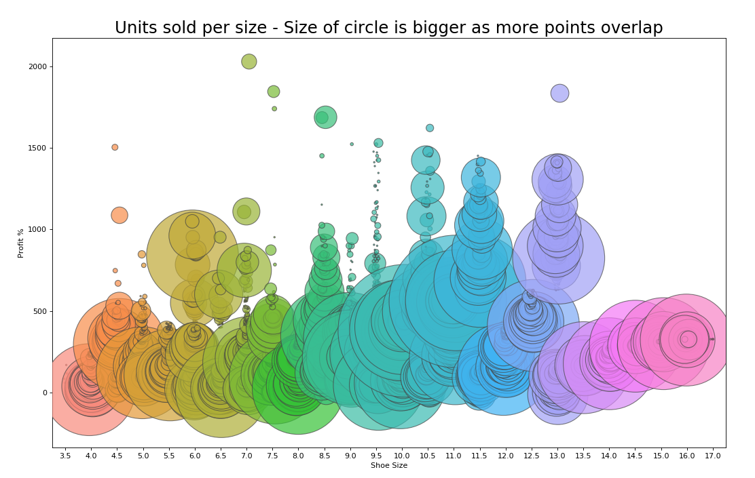
Notes:
KJ: Correlation b/t resell and sizing
Representation of all shoe sizes. The bigger circles show that there are more units sold in that size. You can see from this, if you purchase a size 9-13.5, you stand the highest chance of reselling at a high value.

Slide 9
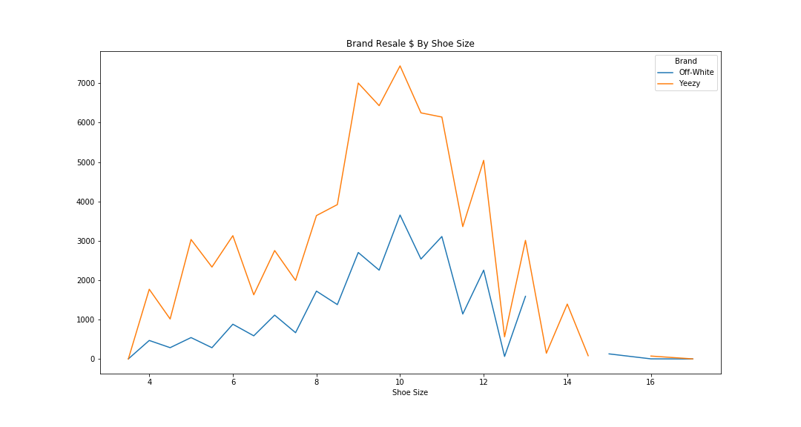
Notes:
KJ: This chart matches the bubble chart above, showing the same spike in shoe size with resell value

Slide 10
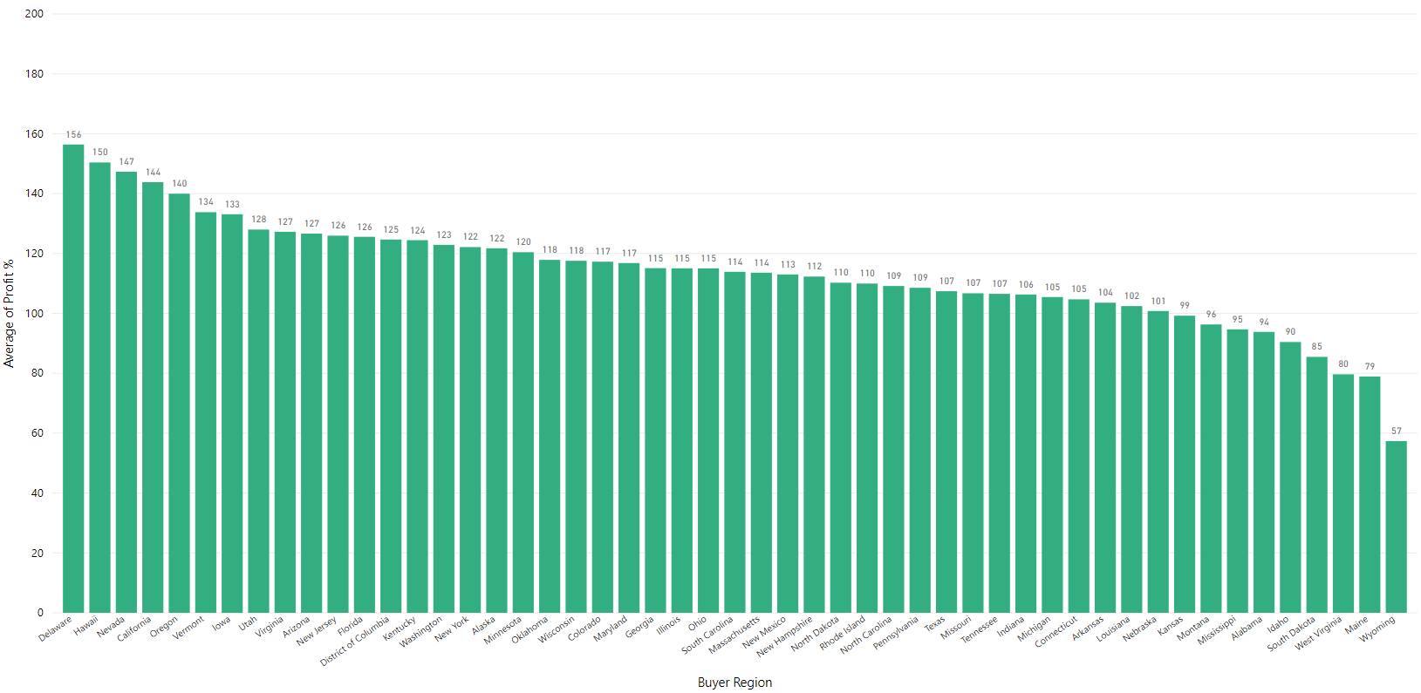
Avg Profit Margin % per State
Notes:
JN

Slide 11
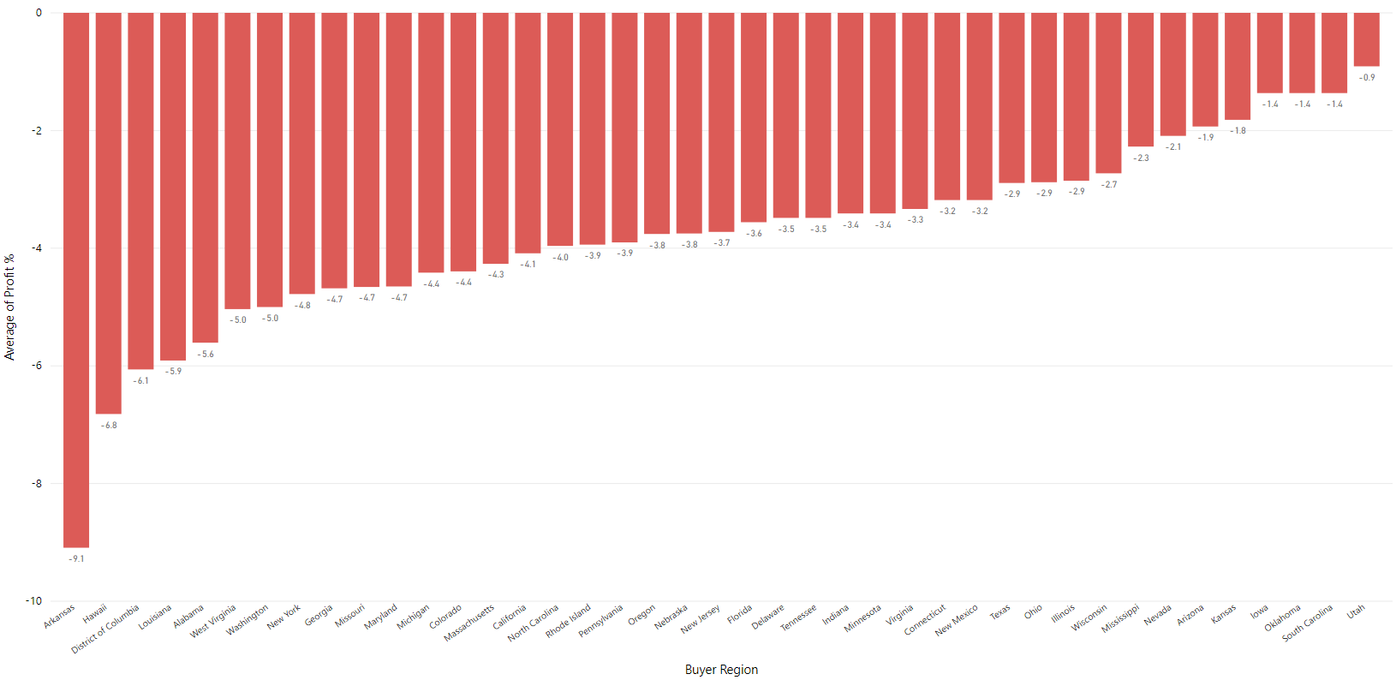
Avg Loss Margin % per State (where applicable)
Notes:
JN

Slide 12
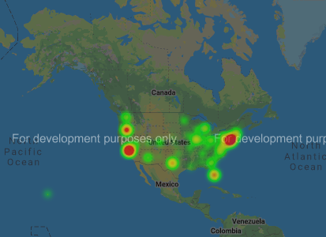
Volume of Dollars Spent in US
Notes:
AV: Top 5 states that spend the most money

Slide 13
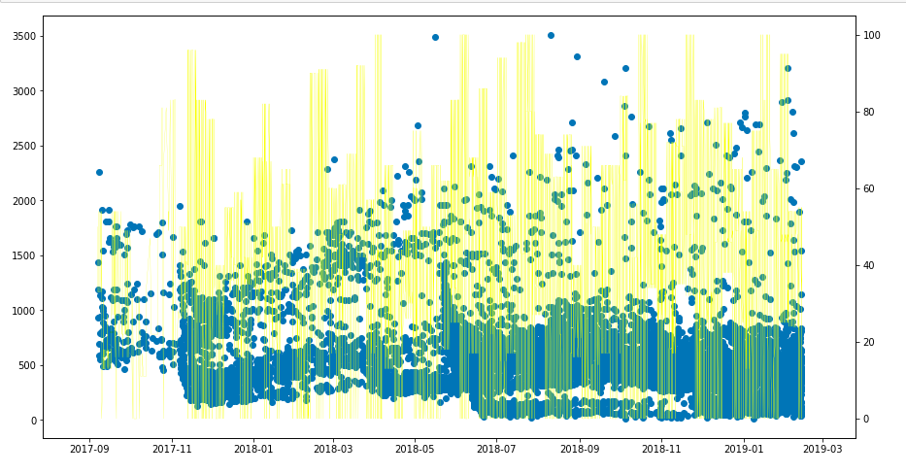
Off White Sales vs Social Media Correlation (Top 5 States)
Notes:
JN

Slide 14
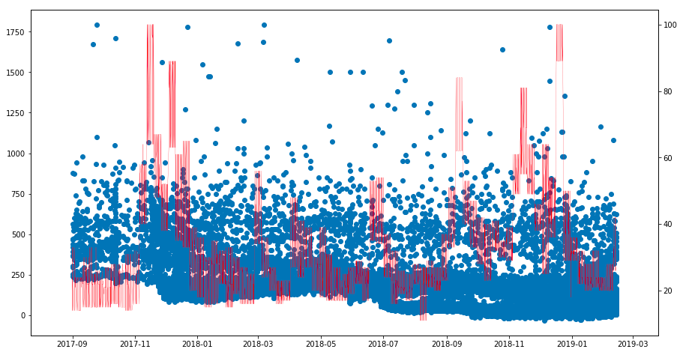
Yeezy Sales by Social Media Correlation (Top 5 States)
Notes:
JN

Slide 15
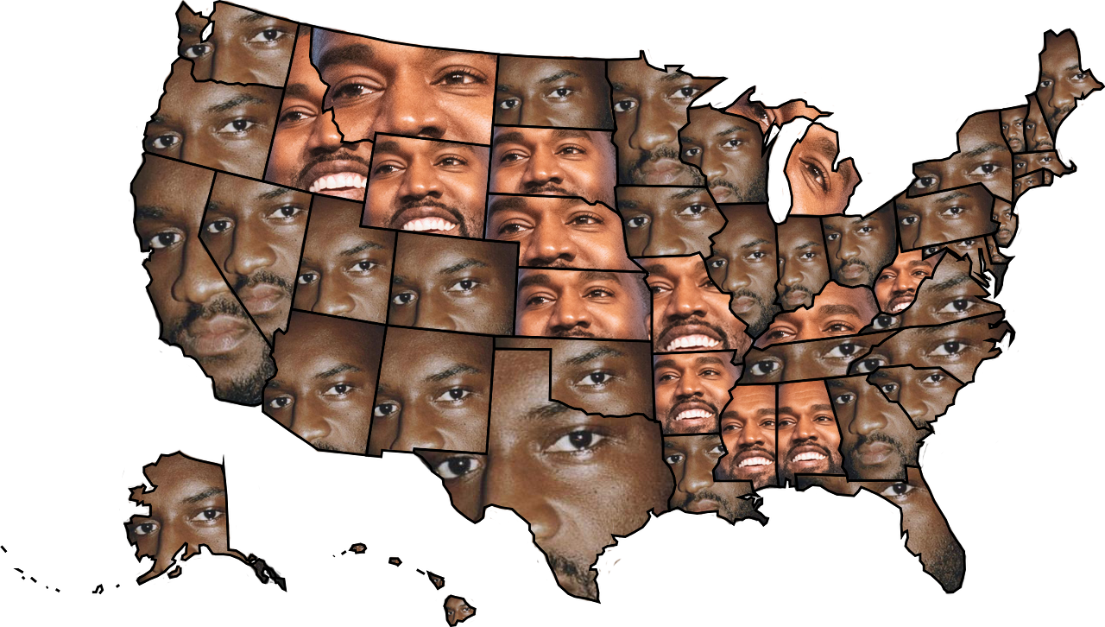
Notes:
JN: Who sold the most in each state – Off White or Yeezy?

Slide 16
Q&A
Notes:
Since social media mentions doesn’t have a strong correlation to resell value, we have found that size, scarcity, region has a stronger impact on the value the sneaker holds in the market.

